Slide 1
Database Concept

Slide 2
Tasks
Assignment-2-
MCQ- 1-
Internal Exam

Slide 3
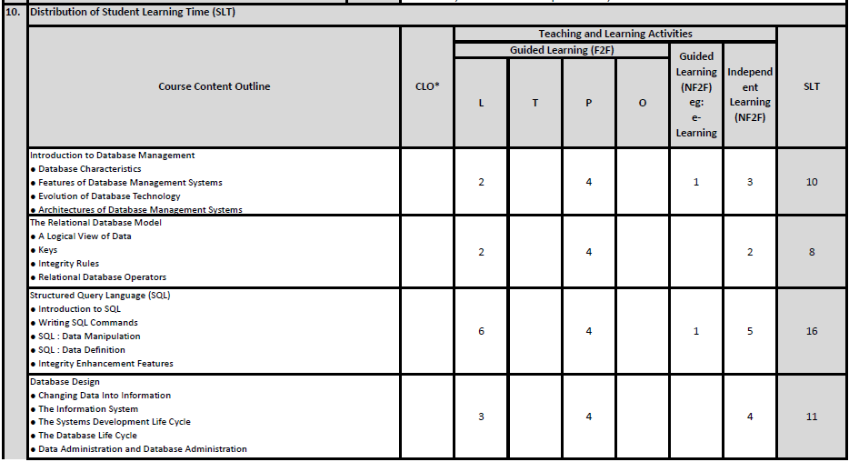

Slide 4
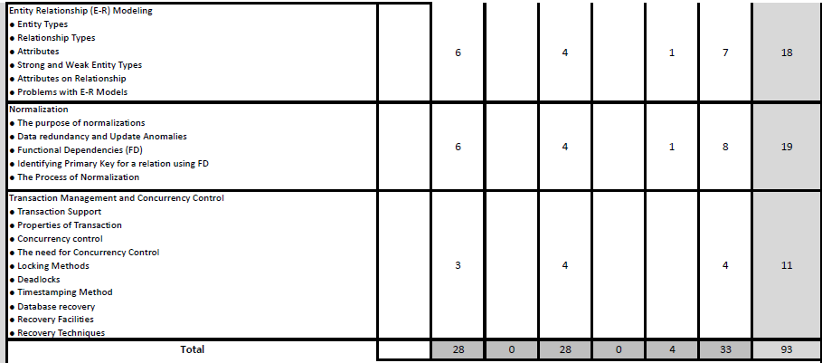

Slide 5
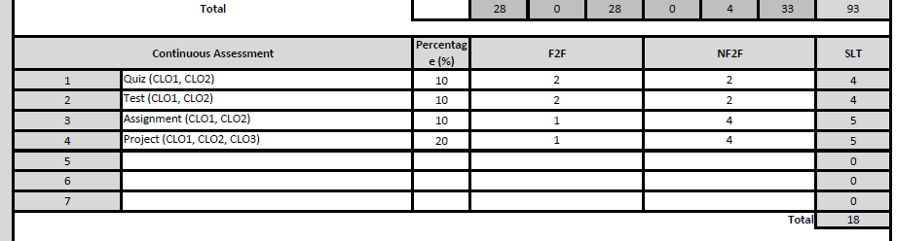

Slide 6
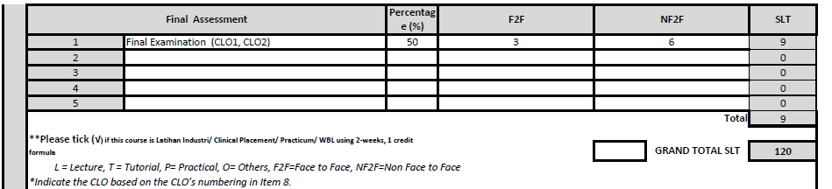

Slide 7
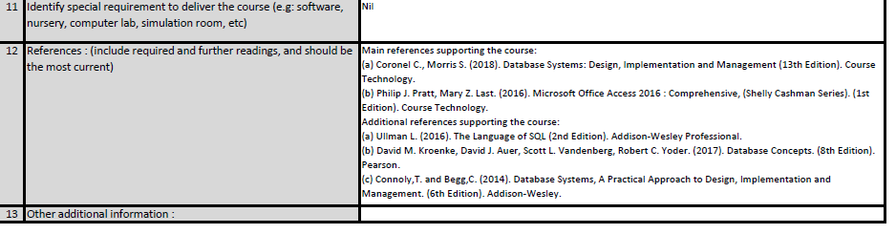

Slide 8
Database system:
A database management system (DBMS) is a computer software application that interacts with the user, other applications, and the database itself to capture and analyze data.
A general-purpose DBMS is designed to allow the definition, creation, querying, update, and administration of databases.
A database management system (DBMS) is a computer software application that interacts with the user, other applications, and the database itself to capture and analyze data.
A general-purpose DBMS is designed to allow the definition, creation, querying, update, and administration of databases.

Slide 9
what is it used for?
The capture and analyzing of data is typically performed by database management systems, otherwise known as DBMSs.
These types of database software systems are programmed in SQL, and
examples include Microsoft SQL Server, MySQL,Oracle SAP HANA and FoxPro.

Slide 10
Purpose of Database:
Purpose of Database Management Systems Organizations use large amounts of data.
A database management system (DBMS) is a software tool that makes it possible to organize data in a database.
The standard acronym for database management system is DBMS, so you will often see this instead of the full name.

Slide 11
Database program:
A database program is the heart of a business information system and provides file creation, data entry, update, query and reporting functions.
The traditional term for database software is "database management system" (see DBMS).

Slide 12
Examples of database:
Some examples of database software are Oracle, FileMaker Pro, Microsoft Access, Microsoft SQL Server, SAP and MySQL.
Database software, also called a database management system or DBMS, is used to store, retrieve, add, delete and modify data.

Slide 13
MySQL:
MySQL is a freely available open source Relational Database Management System (RDBMS) that uses Structured Query Language (SQL).
SQL is the most popular language for adding, accessing and managing content in a database.
It is most noted for its quick processing, proven reliability, ease and flexibility of use.
(SELECT, INSERT, UPDATE, DELETE, TRUNCATE, Select * from table_name)

Slide 14
SQL:
SQL (pronounced "ess-que-el") stands for Structured Query Language. SQL is used to communicate with a database.
According to ANSI (American National Standards Institute), it is the standard language for relational database management systems.
(relation between rows and column)

Slide 15
Database Server:
Database server is the term used to refer to the back-end system of a database application using client/server architecture. The back-end, sometimes called database server, performs tasks such as data analysis, storage, data manipulation, archiving, and other non-user specific tasks.

Slide 16
Purpose of Query:
A database query is designed to retrieve specific results from a database. The query is formulated by the user following predefined formats. After searching through the data, information pertinent to the query is filtered out of the data collection and reported to the user.
Select
StudentName, StudentAddress (Specific Column)
from Student; (Table_Name->Student)
IUKL | StudentName | StudentAddress | Gender
10012 | Rahul Sharma | Kathmandu | Male

Slide 17
Database Application:
A database application is a computer program whose primary purpose is entering and retrieving information from a computerized database. Early examples ofdatabase applications were accounting systems and airline reservations systems, such as SABRE, developed starting in 1957.

Slide 18
Database Management System:
A database management system (DBMS) is system software for creating and managing databases. The DBMS provides users and programmers with a systematic way to create, retrieve, update and manage data.
A database-management system (DBMS) is a collection of interrelated data and a set of programs to access those data.
The collection of data, usually referred to as the database, contains information relevant to an enterprise.
The primary goal of a DBMS is to provide a way to store and retrieve database information that is both convenient and efficient.

Slide 19
Different Types of DBMS:
Relational databases are the most common database systems. They include databases like SQL Server, Oracle Database, Sybase, Informix, and MySQL. The relational database management systems (RDMS) feature much better performance for managing data over desktop database programs. ... A table in RDBMS is like a spreadsheet.

Slide 20
Example of RDBMS:
here are also many free and open-source RDBMS, such as MySQL, mSQL (mini-SQL) and the embedded JavaDB (Apache Derby). A relational database organizes data in tables (or relations). A table is made up of rows and columns. A row is also called a record (or tuple).

Slide 21
Database-System Applications:
Databases are widely used. Here are some representative applications:
Enterprise Information
Sales: For customer, product, and purchase information.
Accounting: For payments, receipts, account balances, assets and other accounting information.
Human resources: For information about employees, salaries, payroll taxes, and benefits, and for generation of paychecks.
Manufacturing: For management of the supply chain and for tracking production of items in factories, inventories of items in warehouses and stores, and orders for items.

Slide 22
◦ Online retailers: For sales data noted above plus online order tracking, generation of recommendation lists, and maintenance of online product evaluations.
Banking and Finance
◦ Banking: For customer information, accounts, loans, and banking transactions.
◦ Credit card transactions: For purchases on credit cards and generation of monthly statements.
◦ Finance: For storing information about holdings, sales, and purchases of financial instruments such as stocks and bonds; also for storing real-time market data to enable online trading by customers and automated trading by the firm.

Slide 23
Universities: For student information, course registrations, and grades (in addition to standard enterprise information such as human resources and accounting).
• Airlines: For reservations and schedule information. Airlines were among the first to use databases in a geographically distributed manner.
Telecommunication: For keeping records of calls made, generating monthly bills, maintaining balances on prepaid calling cards, and storing information about the communication networks.

Slide 24
Limitations of File-Based Approach
Separation and isolation of data -Difficult to access data that is available (eg. from two files – Student that achieved good academic result and active in extra curriculum activities) Duplication of data: -Cost time and money to enter data more than once -Additional storage space is needed - cost -Inconsistencies of data Data dependence: -File structure is defined in the program code. -Changes to an existing structure are difficult to make

Slide 25
Incompatible file formats -Programs are written in different languages, and so cannot easily access each other’s files. Fixed Queries/Proliferation of application programs -Programs are written to satisfy particular functions. -Any new requirement needs a new program.

Slide 26
Limitations of File-Based Approach
Separation and isolation of data
Duplication of data
Data dependence
Incompatible file formats
Fixed queries/proliferation of application programs

Slide 27
Advantages of DBMS
Controlling Data Redundancy: Data is recorded in only one place in the database and it is not duplicated.
Data Consistency: Data item appears only once, and the updated value is immediately available to all users.
Control Over Concurrency : In a computer file-based system in updating, one may overwrite the values recorded by the other.
Backup and Recovery Procedures: automatically
create the backup of data and restore data if required.
Data Independence: Separation of data structure of database from application program that uses the data is called data independence.

Slide 29
Disadvantages of DBMS
Cost of Hardware and Software: Processor with high speed of data processing and memory of large size is required.
Cost of Data Conversion: Very difficult and costly method to convert data of data file into database.
Cost of Staff Training: A lot of amount for the training of staff to run the DBMS.
Appointing Technical Staff: Trained technical persons such as database administrator, application programmers, data entry operators etc. are required to handle the DBMS.
Database Damage: All data is integrated into a single database. If database is damaged due to electric failure or database is corrupted
on the storage media, then your valuable data may be lost forever.

Slide 31
Function Of DBMS
1. Data Storage, retrieval, and update:
A DBMS must provide users with the ability to store, retrieve, and update data in the database.
2. A User-accessible catalog:
A DBMS must provide a catalog in which descriptions of data items are stored and which is accessible to users.
Typically, the system catalog are:
Names, types and sizes of data items; Eg. Name varchar(255)
Names of relationships;

Slide 32
Integrity constraints on the data;
Names of authorized users who have to the data
3.Transaction Support:
A DBMS must provide a mechanism which will either that all the updates corresponding to give performance.

Slide 34
DDL (Data Defin.)
Create, Alter, Drop
Create table Student(
Name varchar(25),
Gender char(1),
M/F
Address varchar(50)
)
Student
Names | Gender | Customer
samik

Slide 35
2. DML() Data Manipulation Language
Rows
Data or Values
Select * from student
where Address = “Bkt”;
Update table student set Address=“POKR”
where Address = “Bkt”;
Insert, Delete, Update, Retrieve(Select)
Name | Address | Gender | PhoneNumber
Shyam | Ktm | M | 014211333
Arjan | POKR | M | 014211334
Anita | Ktm | F | 014211354

Slide 36
Chapter 2
The Relational Database Model
A Logical View of Data
Keys
Integrity Rules
Relational Database Operators

Slide 37
Database Keys
Keys are very important part of Relational database.
They are used to establish and identify relation between tables.
They also ensure that each record within a table can be uniquely identified by combination of one or more fields within a table.

Slide 38
Super Key
Super Key is defined as a set of attributes within a table that uniquely identifies each record within a table.
Super Key is a superset of Candidate key.

Slide 39
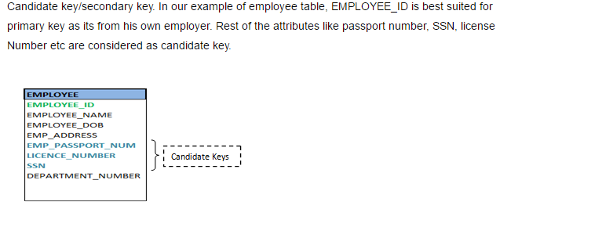
Candidate Key
Candidate keys are defined as the set of fields from which primary key can be selected.
It is an attribute or set of attribute that can act as a primary key for a table to uniquely identify each record in that table.

Slide 40
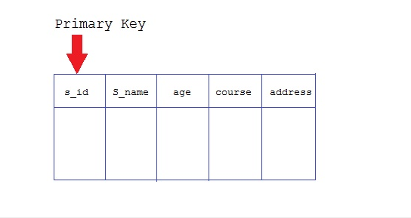
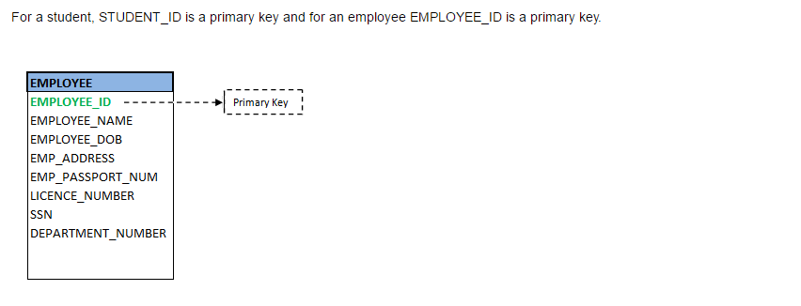
Primary Key
Primary key is a candidate key that is most appropriate to become main key of the table.
It is a key that uniquely identify each record in a table.

Slide 41
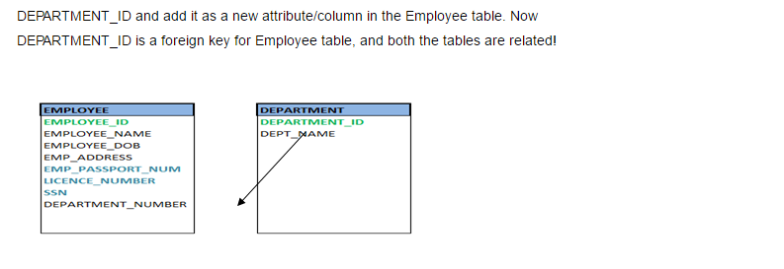
Foreign Key –
Foreign keys are the columns of a table that points to the primary key of another table.
They act as a cross-reference between tables.

Slide 42
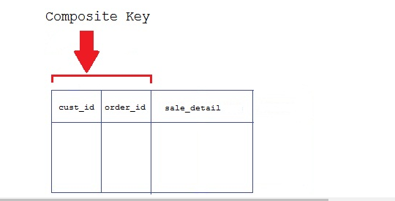
Composite Key
Key that consist of two or more attributes that uniquely identify an entity occurrence is called Composite key.
But any attribute that makes up the Composite key is not a simple key in its own.

Slide 43
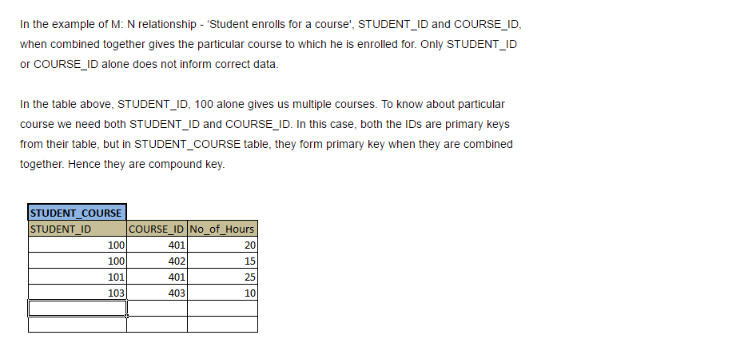
Compound Key

Slide 44
Secondary or Alternative key
The candidate key which are not selected for primary key are known as secondary keys or alternative keys

Slide 47
ER Relationship
When we analyze the information needs of an organization, we attempt to identify entities, attributes, and relationships.
An entity is a distinct object (a person, place, thing, concept, or event) in the organization that is to be represented in the database.
An attribute is a property that describes some aspect of the object that we wish to record,
A relationship is an association between entities.

Slide 48
View
In recognition of this problem, a DBMS provides another facility known as a view mechanism, which allows each user to have his or her own view of the database (a view is in essence some subset of the database).
For example, we could set up a view that allows the Contracts Department to see only the data that they want to see for rental properties.

Slide 49
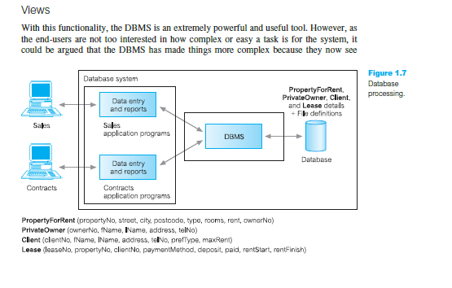

Slide 50
Views provide a level of security:
Views can be set up to exclude data that some users should not see.
For example, we could create a view that allows a branch manager the Payroll Department to see all staff data, including salary details, and we could create a second view that other staff would use that excludes salary details.
Views provide a mechanism to customize the appearance of the database. For example,
the Contracts Department may wish to call the monthly rent field (rent) by the more obvious name, Monthly Rent.

Slide 51
A view can present a consistent, unchanging picture of the structure of the database,
even if the underlying database is changed (for example, fields added or removed, relationships changed, files split, restructured, or renamed).
If fields are added or removed from a file, and these fields are not required by the view, the view is not affected by this change.
Thus, a view helps provide the program–data independence we mentioned in the previous section.

Slide 52
Data Administrator (DA)
The Data Administrator (DA) is
responsible for the management of the data resource including database planning, development and maintenance of standards, policies and procedures, and conceptual/logical database design.
The DA consults with and advises senior managers, ensuring that the direction of database development will ultimately support corporate objectives.

Slide 53
Database Designer:
The logical database designer
is concerned with identifying the data
(that is, the entities and attributes), the relationships between the data, and the constraints on the data that is to be stored in the database.
The logical database designer must have a thorough and complete understanding of the organization’s data and any constraints on this data (the constraints are sometimes called business rules).

Slide 54
Database Architecture
The design of a DBMS depends on its architecture.
It can be centralized or decentralized or hierarchical.
The architecture of a DBMS can be seen as either single tier or multi-tier.
An n-tier architecture divides the whole system into related but independent n modules, which can be independently modified, altered, changed, or replaced.

Slide 55
1-tier architecture
In 1-tier architecture, the DBMS is the only entity where the user directly sits on the DBMS and uses it.
Any changes done here will directly be done on the DBMS itself. It does not provide handy tools for end-users.
Database designers and programmers normally prefer to use single-tier architecture.

Slide 56
2-tier architecture
If the architecture of DBMS is 2-tier, then it must have an application through which the DBMS can be accessed.
Programmers use 2-tier architecture where they access the DBMS by means of an application.
Here the application tier is entirely independent of the database in terms of operation, design, and programming.

Slide 57
Advantages of 2-tier Architecture
Easy to understand as it directly communicates with the database.
Requested data can be retrieved very quickly, when there is less number of users.
Easy to modify – any changes required, directly requests can be sent to database
Easy to maintain – When there are multiple requests, it will be handled in a queue and there will not be any chaos.

Slide 58
Disadvantages of 2-tier architecture:
It would be time consuming, when there is huge number of users.
All the requests will be queued and handed one after another.
Hence it will not respond to multiple users at the same time.
This architecture would little cost effective

Slide 59
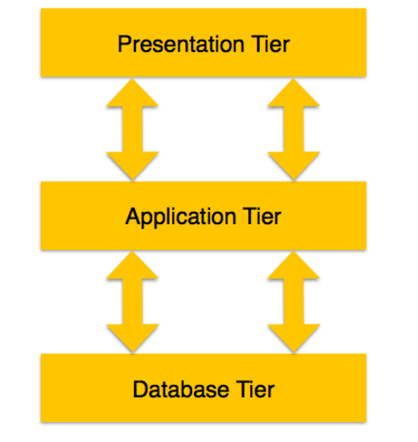
3-tier Architecture
A 3-tier architecture separates its tiers from each other based on the complexity of the users and how they use the data present in the database.
It is the most widely used architecture to design a DBMS.

Slide 60
Advantages of 3-tier architecture:
Easy to maintain and modify. Any changes requested will not affect any other data in the database. Application layer will do all the validations.
Improved security. Since there is no direct access to the database, data security is increased.
There is no fear of mishandling the data. Application layer filters out all the malicious actions.
Good performance. Since this architecture cache the data once retrieved, there is no need to hit the database for each request.
This reduces the time consumed for multiple requests and hence enables the system to respond at the same time.

Slide 61
Disadvantages 3-tier Architecture
Disadvantages of 3-tier architecture are that it is little more complex and little more effort is required in terms of hitting the database.

Slide 63
Database (Data) Tier −
At this tier, the database resides along with its query processing languages.
We also have the relations that define the data and their constraints at this level.

Slide 64
Application (Middle) Tier −
At this tier reside the application server and the programs that access the database.
For a user, this application tier presents an abstracted view of the database.
End-users are unaware of any existence of the database beyond the application.
At the other end, the database tier is not aware of any other user beyond the application tier. Hence, the application layer sits in the middle and acts as a mediator between the end-user and the database.

Slide 65
User (Presentation) Tier −
End-users operate on this tier and they know nothing about any existence of the database beyond this layer.
At this layer, multiple views of the database can be provided by the application.
All views are generated by applications that reside in the application tier.

Slide 66
Three levels of abstraction
Three distinct levels at which data items can be described.
The levels form a three-level architecture comprising an external, a conceptual, and an internal level, as depicted in Figure 2.1.

Slide 67
The Three-Level ANSI-SPARC Architecture
The DBTG (Data Base Task Group) recognized the need for a two-level approach with a system view called the schema and user views called subschemas.
The American National Standards Institute (ANSI) Standards Planning and Requirements Committee (SPARC), ANSI/X3/SPARC, produced a similar terminology and architecture in 1975 (ANSI, 1975).
ANSI-SPARC recognized the need for a three-level approach with a system catalog.
The levels form a three-level architecture comprising an external, a conceptual, and an internal level, as depicted in below figure.

Slide 68
The way users perceive the data is called the external level. The way the DBMS and the operating system perceive the data.
The internal level, where the data is actually stored using the data structures and file organizations described.
The conceptual level provides both the mapping and the desired independence between the external and internal levels.
The objective of the three-level architecture is to separate each user’s view of the database from the way the database is physically represented.

Slide 69
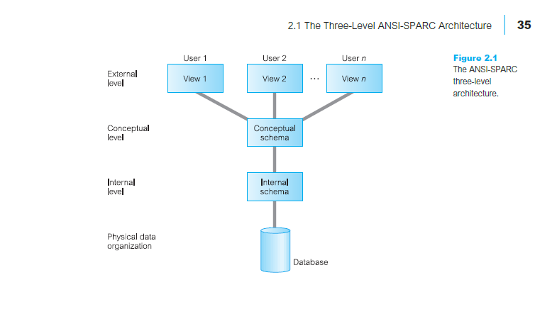

Slide 70
The objective of the three-level architecture is to separate each user’s view of the database from the way the database is physically represented.
There are several reasons why this separation is desirable:
Each user should be able to access the same data, but have a different customized view of the data. Each user should be able to change the way he or she views the data, and this change should not affect other users.
Users should not have to deal directly with physical database storage details, such as indexing or hashing (see Appendix C). In other words, a user’s interaction with the database should be independent of storage considerations.
The Database Administrator (DBA) should be able to change the database storage structures without affecting the users’ views.
The internal structure of the database should be unaffected by changes to the physical aspects of storage, such as the changeover to a new storage device.
The DBA should be able to change the conceptual structure of the database without affecting all users.

Slide 71
External Level
The external level consists of a number of different external views of the database.
Each user has a view of the ‘real world’ represented in a form that is familiar for that user.
The external view includes only those entities, attributes, and relationships in the ‘real world’ that the user is interested in.
Other entities, attributes, or relationships that are not of interest may be represented in the database, but the user will be unaware of them.

Slide 72
In addition, different views may have different representations of the same data.
For example,
one user may view dates in the form (day, month, year), while another may view dates as (year, month, day).

Slide 73
Conceptual level
The community view of the database.
This level describes what data is stored in the database and the relationships among the data.
The middle level in the three-level architecture is the conceptual level.
This level contains the logical structure of the entire database as seen by the DBA.
It is a complete view of the data requirements of the organization that is independent of any storage considerations.
The conceptual level represents:
all entities, their attributes, and their relationships;
the constraints on the data;
semantic information about the data;
security and integrity information.

Slide 74
Internal Level
The physical representation of the database on the computer.
This level describes how the data is stored in the database.
The internal level covers the physical implementation of the database to achieve optimal runtime performance and storage space utilization.
It covers the data structures and file organizations used to store data on storage devices.

Slide 75
It interfaces with the operating system access methods (file management techniques for storing and retrieving data records) to
place the data on the storage devices, build the indexes, retrieve the data, and so on.
The internal level is concerned with such things as:

Slide 76
The internal level is concerned with such things as:
storage space allocation for data and indexes;
record descriptions for storage (with stored sizes for data items);
record placement;
data compression and data encryption techniques.
Below the internal level there is a physical level that may be managed by the operating system under the direction of the DBMS.

Slide 77
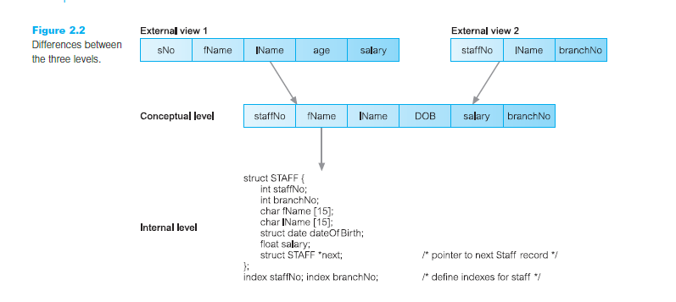

Slide 78
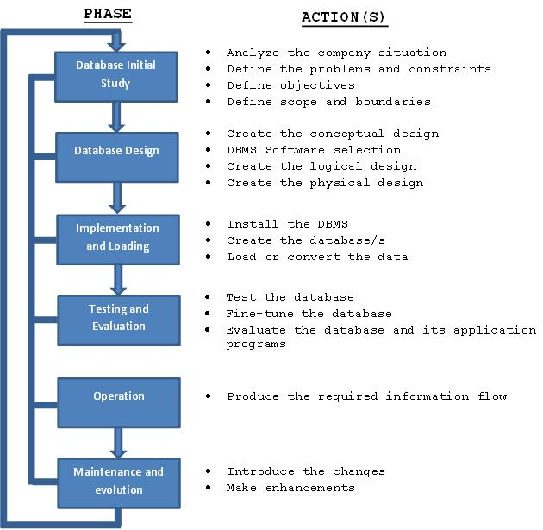
Database Life Cycle

Slide 79
Integrity Rules
Integrity rules may sound very technical but they are simple and straightforward rules that each table must follow.
These are very important in database design, when tables break any of the integrity rules our database will contain errors when retrieving information.
Hence the name "integrity" which describes reliability and consistency of values.
There are two types of integrity rules that we will look at:
Entity Integrity Rule
Referential Integrity Rule

Slide 80
Entity Integrity Rule:
The entity integrity rule refers to rules the primary key must follow.
The primary key value cannot be null.
The primary key value must be unique.
If a table does not meet these two requirements, we say the table is violating the entity integrity rule.

Slide 81
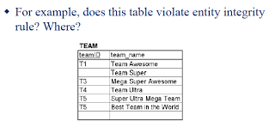

Slide 82
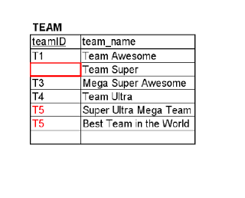
The team table violates the entity integrity rules at two places.
Team Super- missing primary key
Super Ultra Mega Team and Best Team in the World -has the same primary key.

Slide 83
1.2.1 Entity Integrity
According to this constraint each entity of the entity set should be uniquely distinguishable from other entities.
For this purpose no NULL can be assigned to the prime key fields.
For example, consider the following relation STUDENT with Primary Key consisting of (ROLLNO, CLASS)
If NULLS are allowed for prime key fields then consider the following table:
STUDENT
RECNO ROLLNO CLASS NAME DEPTT
1 10321 NULL satish D1
2 10321 NULL ankur D1
3 NULL MCA-I pankaj D1
4 NULL MCA-I jaggu D1
Figure 1.1: Student Table

Slide 84
For record number 1 and 2 of the STUDENT relation the values for ROLLNO field are same and since no CLASS has been defined the records of the corresponding students can not be uniquely identified.
For record numbers 3 and 4 the ROLLNO field is containing NULLS consequently the records once again can not be uniquely identified in the relation.
To overcome this problem the ENTITY INTEGRITY constraint can be specified and no prime key field can contain NULL values and records can be uniquely identified.
Entity Integrity Rule:
No component of a primary key in a base table is allowed to accept null values.

Slide 85
Referential Integrity Rule:
The referential integrity rule refers to the foreign key.
The foreign key may be null and may have the same value but:
The foreign key value must match a record in the table it is referring to.
Tables that do not follow this are violating the referential integrity rule.

Slide 86
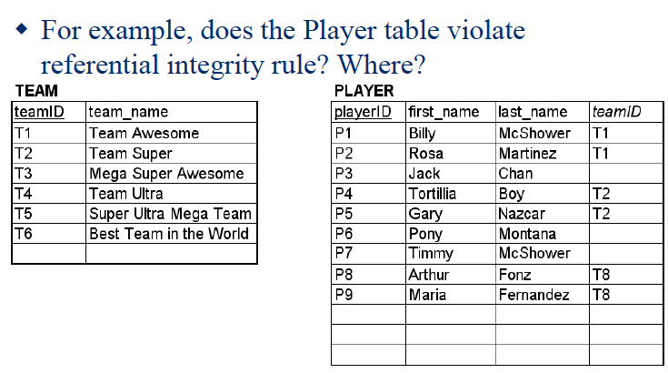

Slide 87
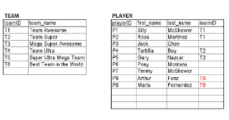
The Player table violates the referential integrity rule at these places:
Player P8 and P9 - these players are in teamID T8, which does not exist in the Team Table.

